Slide 1
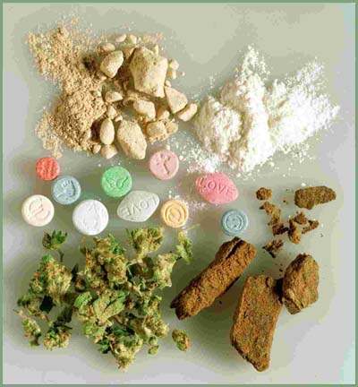
Drugs which are not patentable
Dr. M. Krishnaji Rao
drkrishnajirao@gmail.com

Slide 2
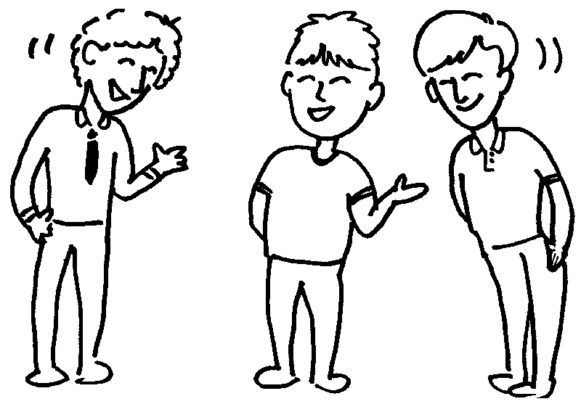
Introduced to …
IPR
Prior art search
Patentable inventions
Patents filing
Patent prosecution

Slide 3
Inventions that are patentable
Categories of eligible inventions
New compounds, new compositions(new formulations)
A process for production of new compounds, new materials, new compositions
Improvements of an existing process for the production of known compounds, known materials, known composition
Synergistic compositions
Medical device/improved medical device
New machine/device
Improved machine/device

Slide 4
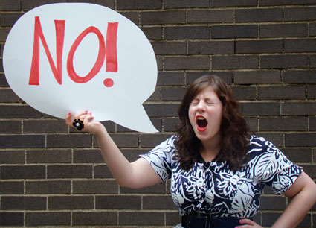
Are all new compounds patentable?

Slide 5
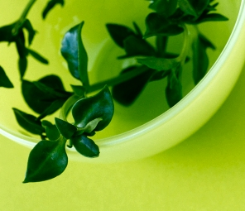
Case study
New herbal drug
Not known to prior art
Showing new therapeutic use
Not known to person skilled in the art
Not known to our traditional medicine or our Indian Aurveda
Patent filed

Slide 6
Why new herbal drug patent rejected?
Chapter II of Indian patents act, 1970
The patents (Amendment) Rules, 2006
Section 3(j)
… plants and animals in whole or any part thereof is not patentable

Slide 7
Case study on drug substance
Known drug substance converted to…
salts
esters
ethers
polymorphs
metabolites
pure form
particle size
isomers
mixtures of isomers
complexes
combinations and
derivatives of known substance

Slide 8
why not patentable?
Chapter II of Indian patents act, 1970
The patents (Amendment) Rules, 2006
Section 3(d)
“the mere discovery of a new form of known substance which does not result in the enhancement of the known efficacy of that substance or the mere discovery of any new property or new use for a known substance or mere use of a known process, machine or apparatus unless such known process results in a new product or employs at least one reactant”

Slide 9
Section 3(d)…
What is an objective of section 3(d)?
To prevent ever-greening of patents
What happens if section 3(d) removed from our act?
Would result in “ever-greening” of patents and delays in the entry of generics, thereby affecting public health.

Slide 10
Section 3(d)…
What are patentable drugs as per section 3(d)?
“ Derivatives with added efficacy patentable”
Section 3(d) encourages sequential development of existing products or technologies that help bring in improved products to the market

Slide 11
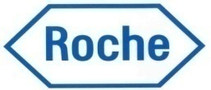
Analysis of section 3(d)
Two case studies:
Glivec, a product of
2. Erlotinib, a product of

Slide 12
The Novartis case
Novartis claimed the polymorph of crystalline imatinib mesylate (brand name Glivec) in a patent application
Patent grant opposed by several Indian companies on several grounds

Slide 13
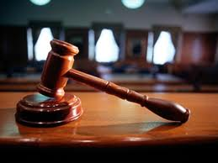
The Novartis case
Whether Novartis’ beta crystalline form is patentable or not under section 3(d)?
“enhancement of known efficacy”
“efficacy” would mean “therapeutic efficacy”

Slide 14
The Roche case
Roche vs Cipla
Roche sued Cipla for patent infringement in 2008 and sought an interlocutory injunction.
Cipla counter claimed that the patent is invalid and should be revoked. Cipla also argued the price difference between the two drugs and the public interest in making life-saving drugs available at an affordable price.

Slide 15
The Roche case
The Delhi high court passed an order rejecting the prayer of Roche for an injunction
No inventive step

Slide 16
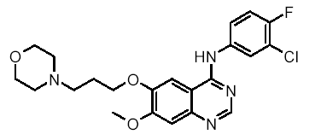
The Roche case
Further analysis of section 3(d)…
Let us consider two possibilities:
Gifatinib Erlotinib
Erlotinib is not a derivative of Gefatinib: Section 3(d) does not apply
Erlotinib is a derivative of Gefatinib: Section 3(d) applies
Relevance of Orphan Drug Act in the context of section 3(d)

Slide 17
Case study…
New drug substance produced by bio-catalytic process, wherein catalysis performed by using microorganism, which was isolated from soil
Can we get a patent for microorganism?
Section 3(c)
…discovery of any living or non-living substance is not patentable

Slide 18
Case study…
“A drug substance, which is a mixture of two drugs having two therapeutic activities which improved patient compliance by taking single dose instead of two drugs individually”
Can we get a patent for the new drug mixture?
No
Section 3(e)
A substance obtained by a mere admixture resulting only in the aggregation of the properties of the components thereof

Slide 19
Case study
“A drug substance which has wound healing property but known to traditional knowledge”
Not patentable
Section 3(p)
Traditional Knowledge or an aggregation or duplication of known properties of traditionally known component or components

Slide 20
In conclusion
The inventions pertaining to drug substances, which fall under section 3 of Indian patent act are not patentable

Slide 21
Be honest to become rich otherwise your attorney becomes rich
Krishnaji Rao

